Slide 1

RAJKIYA ENGINEERING COLLEGE BANDA
Department of Information Technology
Major Project
"Verifying Image Authenticity And Recovery By Merkle Tree-Based Mechanism"
Presented By –
Akash Kumar (2007340130007)
Krishna Pratap Singh (2007340130031)
Prashant Sharma (2007340130042)
Sundaram Sharma (2007340130060)
Guided By –
Dr. Gyan Singh
(Assistant Professor)

Slide 2
Table of Content
Problem Statement
Objective
Introduction
Literature Review
Proposed Method
Conclusion
Reference

Slide 3
Problem Statement
Verifying Image Authenticity And Recovery By Merkle Tree-Based Mechanism.

Slide 4
Objective
Generate a new image authentication method based on Merkle Tree.
User friendly UI so that user can easily upload their image.
Detect the damaged part of the image if altered.
Recovery of the damaged part.

Slide 5
Introduction
In today's digital age, ensuring the authenticity and integrity of images is crucial, especially in sensitive sectors like healthcare, forensics, and legal documentation.
We'll explore how Merkle Trees, a cryptographic data structure, can be employed to authenticate and recover images efficiently and securely. To authenticate an image using a Merkle Tree, we first divide the image into fixed-size blocks. We then compute the hash of each block and construct a Merkle Tree. The root hash of the tree serves as the unique fingerprint of the image, ensuring its integrity.

Slide 6
Literature Review
Sr. NO. | Author | Title | Techniques used | Source | Finding of the study
1. | Marakumbi Prakash, Jayashree V. Khanapuri(2018) | A Study on Image Authentication Methods | Cryptographic Authentication, Watermarking Authentication. | IRJET | Watermarking scheme constructed based on chaotic maps is more efficient compared to other methods.
2. | Adil Hauzia, Rita Noumeir (2007) | Methods of Image Authentication : a survey | Fragile Watermarking, Semi Fragile Watermarking Methods | Springer | Fragile watermarking detects tampering, semi-fragile tolerates changes, and content-based methods enhance security.
3. | Aravindh Raman, Gareth Tyson(2022) | Design and Evaluation of IPFS | - | SIGCOM | Working of IPFS.

Slide 7
Sr. No. | Author | Title | Technique used | Source | Finding of the Study
4. | B. Padmavathi, S. Ranjitha Kumari(2013) | A survey on performance analysis of DES,AES and RSA. | Encryption and Decryption | IJSR | Analysis of DES, AES, RSA.
5. |  | AES implementation | Encryption and decryption | Wikipedia | Working of AES.
6. | Prof. Dr. Johanners Buchmann Supervised by Erik Dahmen (2007) | Merkle tree traversal techniques |  | citeseerx | How Merkle tree implemented

Slide 8
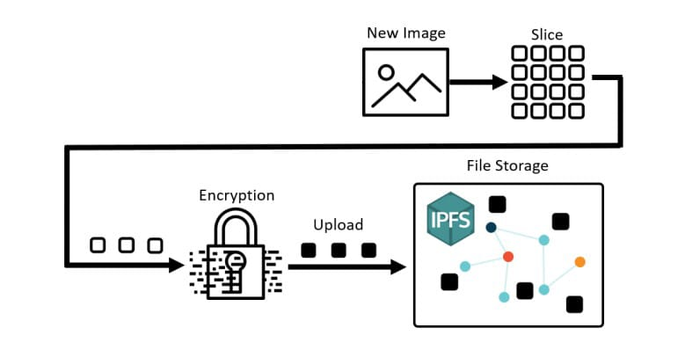
Project Methodology
Step 1: User upload real and damaged image on interface.
Step 2: We divided image into several slices as block of image using image processing libraries.
File System: This is the Node.js file system module used for interacting with the file system.
Canvas: This is a library for creating and manipulating canvas elements in Node.js. It's commonly used for generating images programmatically.

Slide 9
Project Methodology
Step 3: AES 256 encryption technique is used to encrypt the block of pixels.

Slide 10
Project Methodology
Step 4: After encryption of block of image we upload these block of pixels into IPFS( Inter-Planetary file system) as distributed data storage.

Slide 11
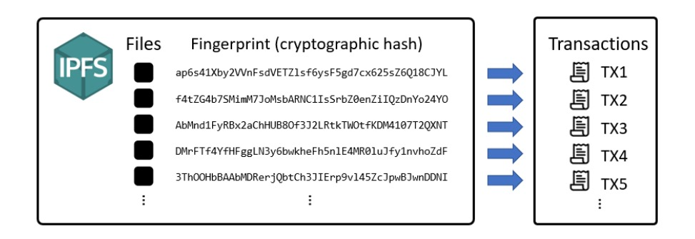
Project Methodology
Step 5: In IPFS (inter planetary file system) some operations are performed on encrypted blocks and it give result in the form of cid’s of those blocks.

Slide 12
Project Methodology
Step 6: In this step, we compare the transactions of real image and damaged image. We found that cid’s of these two images are different.
Step 7: In this step, we fetch encrypted blocks of image from cid’s.
Step 8: In this step, we use AES 256 decryption technique to decrypt the blocks of image(We get them from fetching process) and get decrypted blocks of image.

Slide 13
Project Methodology
Step 9: In this step, if there is change in cid’s than we highlight the damaged blocks of image otherwise blocks remains same.
Step 10: In this step, we convert those decrypted blocks of image into image by using image processing libraries.
Step 11: The user gets the result of identifying damaged image on the screen of interface, in which damaged blocks are highlighted.

Slide 14
Work Flow Chart (Image Verification)
Start
Get image from user
Generate Merkle tree of image
Compare merkle tree
Get merkle root of original image
Not equal
Image is altered
Image is not altered
End

Slide 15
Conclusion
The project involves uploading real and damaged images, dividing them into pixel blocks, encrypting with AES 256, and storing on IPFS. Differences in IPFS transactions indicate damage. Retrieving and decrypting blocks reveals damaged areas, highlighted for user identification. Overall, it's a secure and efficient method for detecting image damage.

Slide 16
Reference
https://arxiv.org/abs/1407.3561
https://www.irjet.net/archives/V5/i12/IRJET-V5I12321.pdf
https://dl.acm.org/doi/abs/10.1145/800105.803400
https://link.springer.com/chapter/10.1007/978-3-540-246763_32
https://dspace.mit.edu/bitstream/handle/1721.1/149957/MIT-LCS-TR-857.pdf?sequence=1&isAllowed=y
https://www.pinata.cloud/
https://nodejs.org/en
https://ipfs.tech/

Slide 17
THANK YOU

